Slide 1

Lecturer: Eng. Mahdi Obsiyeh
CCNP
Eelo University
Faculty of IT, TE, BIT
Borama, Somaliland

Slide 2
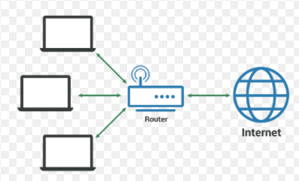
IP-address SUBNETTING Chapter 3

Slide 3
In this chapter, you will learn to:
Explain the structure IP addressing and demonstrate the ability to convert between 8-bit binary and decimal numbers.
Given an IPv4 address, classify by type and describe how it is used in the network.
Explain how addresses are assigned to networks by ISPs and within networks by administrators.
Determine the network portion of the host address and explain the role of the subnet mask in dividing networks.
Use common testing utilities to verify and test network connectivity and operational status of the IP protocol stack on a host.

Slide 4
Introduction
An Internet Protocol address (IP address) is a numerical label assigned to each device (e.g., computer, printer) participating in a computer network that uses the Internet Protocol for communication.

Slide 5
The Structure of an IPv4 Address
At the Network layer, the packets need to be identified with the source and destination addresses of the two end systems.
Each device on a network must be uniquely defined.
Dotted Decimal; Binary; Octet
Each byte of the binary pattern, called an octet.
Each decimal number represents one byte or 8 bits, or an octet.
Binary address:
10101100 00010000 00000100 00010100
Dotted decimal address:
172.16.4.20

Slide 6
There are two types of IP address
IPv4 (32 bit)
IPv6 (128 bit)
IPv4 addresses consist of 32 bit
What is a bit? Bit is either 0 or 1
Every each 8 bit = 1 byte or 1 Octet there for IP address consist of 4 Byte and it can be represented as 8.8.8.8
IP address can be either public IP address or private IP address
Public IP address: is an IP address that can be accessed over the Internet. Like http://www.eelouniversity.org/
Private IP address: Private IP address is used for internet organization, offices, campus, university, hospitals and etc.

Slide 7
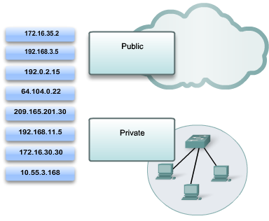
Public and Private Addresses

Slide 8
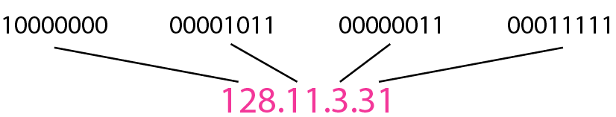
The IPv4 addresses are unique and universal/public.
An IPv4 address is 32 bits long.
The address space of IPv4 is 2³² (4,294,967,296)
Notation.
Binary notation
Dotted-decimal notation

Slide 9
IP ADDRESS: is divided into two 5 classes A, B, C, D, E
CLASS | Start - End | Default subnet mask | Bit for the network | Bits for the host | Hosting
A | 1 - 126 | 255.0.0.0 | /8 bits network | 24 bits | 16.777.214 (2²⁴-2 )
B | 128 - 191 | 255.255.0.0 | /16 bits network | 16 bits | 65.534 (2¹⁶-2)
C | 192 - 223 | 255.255.255.0 | /24 bits network | 8 bits | 254 (²⁸-2)
D | 224 - 239 | Class D is used for multicasting purpose
E | 240 - 255 | Class E is reserved for future use

Slide 10
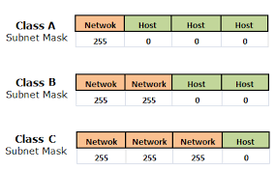

Slide 11
IP address class A network, examples
IP address class B network, examples
1.2.3.0 | 20.30.10.0 | 120.120.1.0
2.3.11.0 | 30.10.20.0 | 17.19.20.0.
5.1.2.0 | 45.45.45.45. | 69.12.12.0
126.10.10.0 | 111.111.123.140. | 80.0.0.0
128.10.12.0 | 172.60.60.0 | 190.0.0.0
140.30.20.0 | 172.31.16.0 | 191.20.1.0
177.67.12.0 | 191.191.0.0 | 150.150.150.0
160.10.17.0 | 129.40.40.0 | 140.140.12.0

Slide 12
IP address class C network, examples
192.100.100.0 | 200.0.200.0 | 223.20.100.0
193.10.20.0 | 195.195.100.0 | 222.222.222.0
199.0.13.0 | 192.168.10.0 | 198.160.160.0
210.97.92.0 | 192.168.20.0 | 209.209.10.0

Slide 13
Private IP Address
CLASS | Start - End | Default subnet mask | Bit for the network | Bits for the host | Private IP Address starting | Private IP address End
A | 1 - 126 | 255.0.0.0 | /8 bits network | 24 bits | 10.0.0.0 | 10.255.255.255
B | 128 - 191 | 255.255.0.0 | /16 bits network | 16 bits | 172.16.0.0 172.17.0.0 172.18.0.0 172.19.0.0 upto 172.31.0.0 | 172.16.255.255 172.17.255.255 172.18.255.255 172.19.255.255 172.31.255.255
C | 192 - 223 | 255.255.255.0 | /24 bits network | 8 bits | 192.168.0.0
D | 224 - 239 | Class D is used for multicasting purpose
E | 240 - 255 | Class E is reserved for future use

Slide 14
Class A Subnet Mask | Network | Host | Host | Host
 | 255 | 0 | 0 | 0
Class A Subnet Mask | Network | Network | Host | Host
 | 255 | 255 | 0 | 0
Class A Subnet Mask | Network | Network | Network | Host
 | 255 | 255 | 255 | 0

Slide 15
Understanding base value and position
Bit Position | 8 | 7 | 6 | 5 | 4 | 3 | 2 | 1
Position Value | 128 | 64 | 32 | 16 | 8 | 4 | 2 | 1
In Binary | 1 | 1 | 1 | 1 | 1 | 1 | 1 | 1

Slide 16
Examples of IP address in decimal notation are following: -
172.168.1.1
192.168.1.1
Examples of IP address in binary notation are following: -
10101100.10101000.00000001.00000001
11000000.10101000.00000001.00000001

Slide 17
Examples of subnet mask in decimal notation are following: -
255.0.0.0
255.255.0.0
255.255.255.0
Examples of subnet mask in binary notation are following: -
11111111.00000000.00000000.00000000
11111111.11111111.00000000.00000000
11111111.11111111.11111111.00000000

Slide 18
Decimal to Binary
Example 1
192. 168. 25. 0
00000000
11000000
10101000
00011001

Slide 19
Example 2
10. 8. 255. 172
10101100
00001010
00001000
11111111

Slide 20
Binary to Decimal
Example 3
11000000.10101000.00000001.00000001
192
168
1
1

Slide 21
Example 4
00001100. 01100100. 10010110. 11111010
10
100
150
250

Slide 22
What is the Subnetting
Subnetting enables the network administrator to further divide the host part of the address into two or more subnets. In this case, a part of the host address is reserved to identify the particular subnet

Slide 23
Subnetting IPv4
Advantage of subnetting = Better IP management.
Sometimes happen that you are network administrator and managing/controlling Telesom company.
Telesom company have different sections, sales, financial, IT, management, SIM card, and cashier dept and each part have their computers and printers, If they need 70 IP address and you provide 254 IP- address, it seems that you lost many ip address (184 IP address).

Slide 24
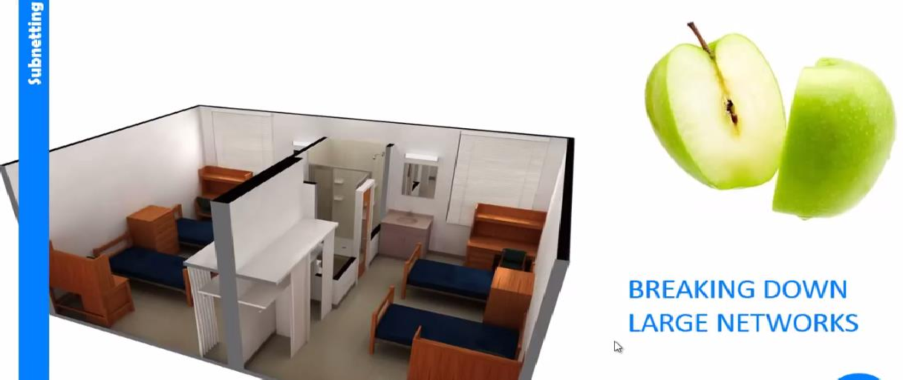

Slide 25
Stealing bits from host bits class-A
 | IP Address 192 168 10 15
 | Subnet Mask | 255 |  |  | 0 |  | 0 |  | 0
 |  | 1111 1111 |  |  | 0000 0000 |  | 0000 0000 |  | 0000 0000
Weight |  |  | 128 | 64 |  | 32 |  | 16 |  | 8
Borrowed Bits |  |  | 1 | 2 |  | 3 |  | 4 |  | 5
Sub-Network |  |  | 2 | 4 |  | 8 |  | 16 |  | 32

Slide 26
Stealing bits from host bits class-B
 | IP Address 192 168 10 15
 | Subnet Mask | 255 |  |  | 255 |  | 0 |  | 0
 |  | 1111 1111 |  |  | 1111 1111 |  | 0000 0000 |  | 0000 0000
Weight |  |  | 128 | 64 |  | 32 |  | 16 |  | 8
Borrowed Bits |  |  | 1 | 2 |  | 3 |  | 4 |  | 5
Sub-Network |  |  | 2 | 4 |  | 8 |  | 16 |  | 32

Slide 27
Stealing bits from host bits class-C
 | IP Address 192 168 10 15
 | Subnet Mask | 255 |  |  | 255 |  | 255 |  | 0
 |  | 1111 1111 |  |  | 1111 1111 |  | 1111 1111 |  | 0000 0000
Weight |  |  | 128 | 64 |  | 32 |  | 16 |  | 8
Borrowed Bits |  |  | 1 | 2 |  | 3 |  | 4 |  | 5
Sub-Network |  |  | 2 | 4 |  | 8 |  | 16 |  | 32

Slide 28
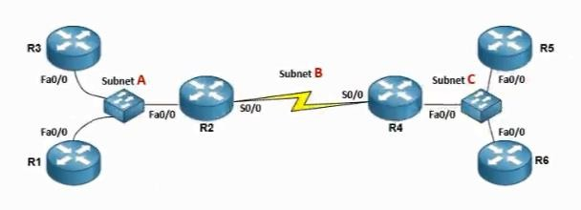
Weight | 128 | 64 | 32 | 16 | 8 | 4 | 2 | 1
Borrowed Bits | 1 | 2 | 3 | 4 | 5 | 6 | 7 | 8
Sub-Network | 2 | 4 | 8 | 16 | 32 | 64 | 128 | 255

Slide 29
PREFIX TO SUBNET MASK
Weight | 128 | 64 | 32 | 16 | 8 | 4 | 2 | 1
Borrowed Bits | 1 | 2 | 3 | 4 | 5 | 6 | 7 | 8
Sub-Network | 2 | 4 | 8 | 16 | 32 | 64 | 128 | 255
Prefix | /25 | /26 | /27 | /28 | /29 | /30 | /31 | /32
Hosts (2^n – 2 =) | 126 | 62 | 30 | 14 | 6 | 2 | 0 | 0

Slide 30
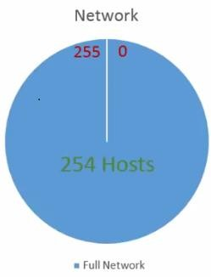

Slide 31
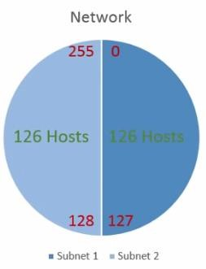

Slide 32
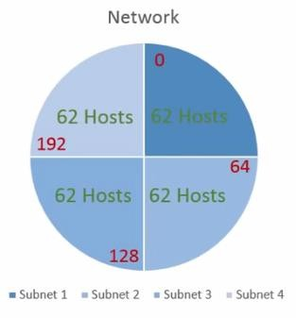

Slide 33
Block Size | 128 | 64 | 32 | 16 | 8 | 4 | 2 | 1
Borrowed Bits | 1 | 2 | 3 | 4 | 5 | 6 | 7 | 8
Sub-Network | 2 | 4 | 8 | 16 | 32 | 64 | 128 | 255
Prefix | /25 | /26 | /27 | /28 | /29 | /30 | /31 | /32
Hosts | 126 | 62 | 30 | 14 | 6 | 2 | 0 | 0
Subnet mask | 128 | 192 | 224 | 240 | 248 | 252 | 254 | 255

Slide 34
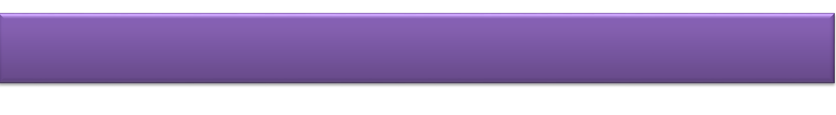


Prefix to Block
8
16
24
25
26
27
28
29
30
31
32
1 | 9 | 17 | 25 | = | 128
2 | 10 | 18 | 26 | = | 64
3 | 11 | 19 | 27 | = | 32
4 | 12 | 20 | 28 | = | 16
5 | 13 | 21 | 29 | = | 8
6 | 14 | 22 | 30 | = | 4
7 | 15 | 23 | 31 | = | 2
8 | 16 | 24 | 32 | = | 1

Slide 35
Classless Inter-Domain Routing
(CIDR)
/1 | 128.0.0.0 |  | /9 | 255.128.0.0 |  | /17 |  | 255.255.128.0 |  |  | /25 | 255.255.255.128
/2 | 192.0.0.0 |  | /10 | 255.192.0.0 |  | /18 |  | 255.255.192.0 |  |  | /26 | 255.255.255.192
/3 | 224.0.0.0 |  | /11 | 255.224.0.0 |  | /19 |  | 255.255.224.0 |  |  | /27 | 255.255.255.224
/4 | 240.0.0.0 |  | /12 | 255.240.0.0 |  | /20 |  | 255.255.240.0 |  |  | /28 | 255.255.255.240
/5 | 248.0.0.0 |  | /13 | 255.248.0.0 |  | /21 |  | 255.255.248.0 |  |  | /29 | 255.255.255.248
/6 | 252.0.0.0 |  | /14 | 255.252.0.0 |  | /22 |  | 255.255.252.0 |  |  | /30 | 255.255.255.252
/7 | 254.0.0.0 |  | /15 | 255.254.0.0 |  | /23 |  | 255.255.254.0 |  |  | /31 | 255.255.255.254
/8 | 255.0.0.0 |  | /16 | 255.255.0.0 |  | /24 |  | 255.255.255.0 |  |  | /32 | 2255.255.255.255
128 |  | 64 |  | 32 | 16 |  | 8 |  | 4 | 2 |  | 1 | 0

Slide 36
Variable-Length Subnet Masking (VLSM)
Variable-Length Subnet Masking (VLSM) amounts to “Subnetting subnets," which means that VLSM allows network engineers to divide an IP address space into a hierarchy of subnets of different sizes, making it possible to create subnets with very different host counts without wasting large numbers of addresses

Slide 37
Variable Length Subnet Mask
(VLSM)
Network | Host | Block Size | Network Address | Subnet Mask
1 | 2 | 4 | 192.168.10.0/30 | 255.255.255.252
2 | 2 | 4 | 192.168.10.4/30 | 255.255.255.252
3 | 2 | 4 | 192.168.10.8/30 | 255.255.255.252
4 | 2 | 4 | 192.168.10.12/30 | 255.255.255.252
5 | 30 | 32 | 192.168.10.32/27 | 255.255.255.224
6 | 8 | 16 | 192.168.10.16/28 | 255.255.255.240
7 | 12 | 16 | 192.168.10.224/28 | 255.255.255.240
8 | 30 | 32 | 192.168.10.192/27 | 255.255.255.224
9 | 60 | 64 | 192.168.10.64/26 | 255.255.255.192
10 | 45 | 64 | 192.168.10.128/26 | 255.255.255.192

Slide 38
128.64.32.16.8.4.2.1 - 128.64.32.16.8.4.2.1 - 128.64.32.16.8.4.2.1 - 128.64.32.16.8.4.2.1
/24 | 255 | 255 | 255 | 0
/25 | 255 | 255 | 255 | 128
/26 | 255 | 255 | 255 | 192
/27 | 255 | 255 | 255 | 224
/28 | 225 | 255 | 255 | 240
/29 | 225 | 255 | 255 | 248
/30 | 255 | 255 | 255 | 252

Slide 39
Network formula
Network | 2^{N}
host | 2^{N} -2
Network address
Frist host
Last host
Broad cast address

Slide 40
/25
Network = | 2¹ | 2 network
Host = | 2⁷ - 2 | 128 -2 = 126 host
Network address = | 256-128 | 0 | 128
Frist host = |  | 1 | 129
Last host = |  | 126 | 254
Broadcast address = |  | 127 | 255

Slide 41
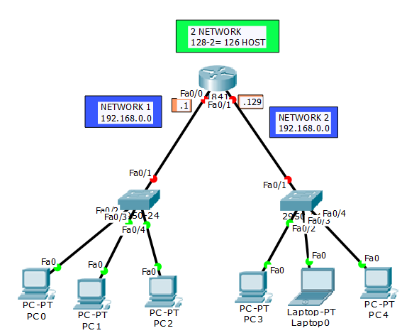

Slide 42
/26
Network = | 2² | 4 network
Host = | 2⁶ - 2 | 64 -2 = 62 host
Network address = | 256-192 | 0 | 64 | 128 | 192
Frist host = |  | 1 | 65 | 129 | 193
Last host = |  | 62 | 126 | 190 | 255
Broadcast address= |  | 63 | 127 | 191 | 256

Slide 43
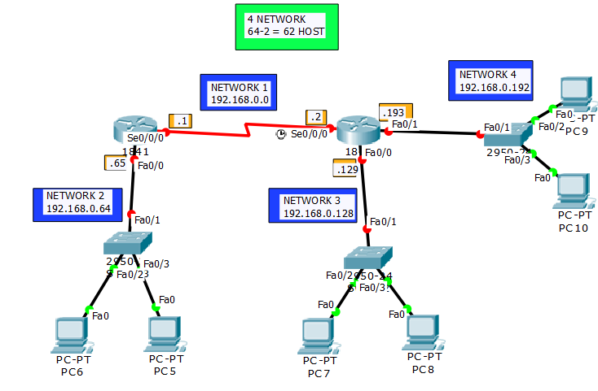

Slide 44
Class-ACTIVITY
/27 and /28
Network =
Host =
Network address =
Frist host =
Last host =
Broadcast address =

Slide 45
Subnetting

Slide 46
Home work Assignment
DO THIS class A subenetting mask
/4
/9
/13
Do this class B subnetting mask
/18
/20
/23
Do this class C subnetting mask
/28
/29
/30

Slide 47
End

